Slide 1
Algorithm & Analysis
Sorting, Searching, Divide & Conquer, Analysis
Unit-03

Slide 2
Sorting
Unit-03.01

Slide 3
Why?
….an open-ended question

Slide 4
Data Presentation: Sorted data is easier for humans to interpret and work with. Whether it's a list of names, numbers, or any other type of data, sorting makes it easier to find specific items, identify patterns, and analyze trends.
Preprocessing: Sorting is often a crucial step in preprocessing data before performing other operations. It helps in tasks like duplicate removal, data cleaning, and aggregation, which are common in data analysis and database management.
Data Compression and Encoding: Sorted data can sometimes be compressed more effectively, leading to better compression ratios in data storage and transmission. Additionally, sorted data can simplify encoding schemes, reducing the overhead of representing the data.
Optimization: Sorting can often lead to optimization opportunities in various applications. For instance, in databases, sorted indexes can significantly improve query performance. In graphics rendering, sorting objects based on their depth can optimize rendering algorithms. Sorting also facilitates efficient merging and joining of datasets, which is essential in various data processing tasks.
Efficiency: Sorting allows for efficient searching, as sorted data can be easily searched using algorithms like binary search, which has a time complexity of O(log n). Unsorted data typically requires linear search, which has a time complexity of O(n). In scenarios where there is a large volume of data, the efficiency gained from sorting becomes crucial.
Algorithm Design and Analysis: Many algorithms and data structures rely on sorted data or perform better when the data is sorted. For example, various divide-and-conquer algorithms, such as merge sort and quicksort, heavily rely on sorting as a subproblem. Analyzing the time complexity and efficiency of algorithms often involves considering how they handle sorted or partially sorted data.
Decision Making: Sorted data can facilitate decision-making processes by providing a clear hierarchy or order. For example, in financial markets, sorted data helps investors identify top performers or detect anomalies more efficiently.

Slide 5
2
1
4
1
3
9

Slide 6
Rules are simple
- You can view 2 box at max
- You can swap only two boxes at a time
?
?
?
?
?
?
3
6
2
4
7
9

Slide 7
SelectionSort
Unit-03.01.01

Slide 8
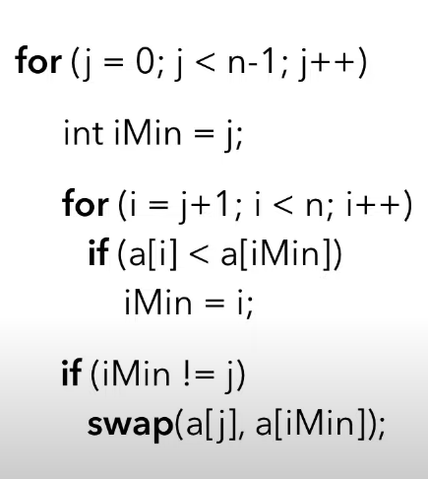
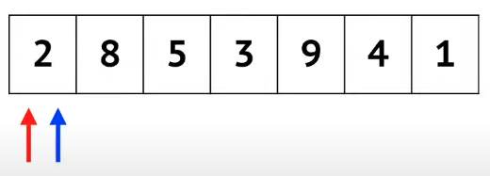
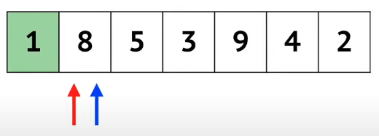
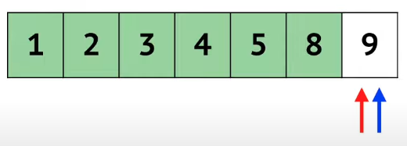
Current Min
Current Item

Slide 9
How many times this would run?

Slide 10
Complexity Analysis
Unit-03.02

Slide 11
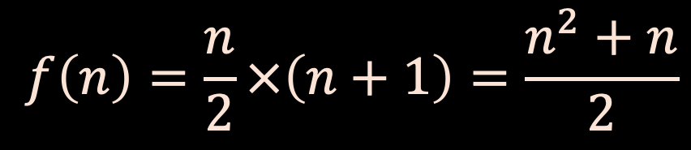
$$f\left(n\right)=\frac{n}{2}×\left(n+1\right)=\frac{n^{2}+n}{2}$$

Slide 12
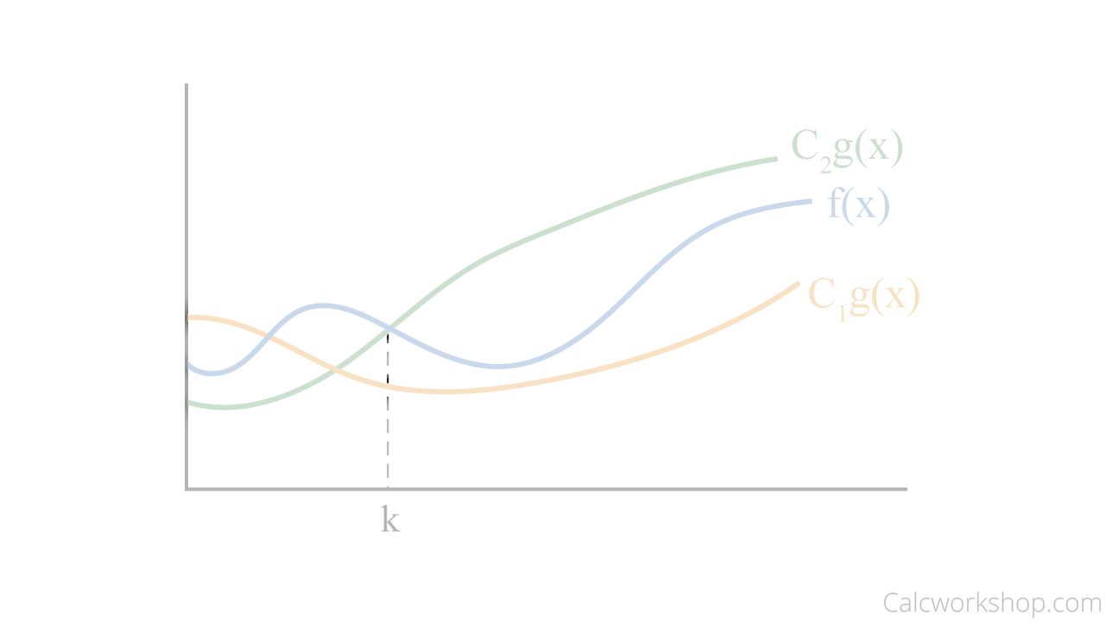


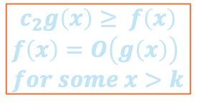

Complexity Analysis
FUNCTION GROWTH
Time Complexity: Time complexity measures the amount of time an algorithm takes to execute as a function of the size of the input. It provides an upper bound on the running time of an algorithm.
Space Complexity: Space complexity measures the amount of memory space an algorithm requires as a function of the input size.
$$x→∞$$
$$c_{2}g\left(x\right)≥ f\left(x\right)$$
$$f\left(x\right)=O\left(g\left(x\right)\right)$$
$$for some x>k$$
$$c_{2}g\left(x\right)≥ f\left(x\right)≥c_{1}g\left(x\right)$$
$$f\left(x\right)=Ω\left(g\left(x\right)\right)$$
$$for some x>k$$
Best, Worst, and Average Cases: Algorithms can have different time and space complexities depending on the characteristics of the input data.
$$c_{2}g\left(x\right)≥ f\left(x\right)≥c_{1}g\left(x\right)$$
$$f\left(x\right)=Θ\left(g\left(x\right)\right)$$
$$for some x>k$$
Asymptotic Analysis: Complexity analysis typically focuses on the behavior of an algorithm as the input size approaches infinity. This is known as asymptotic analysis. It helps identify the dominant factors affecting the algorithm's performance and disregards constants and lower-order terms, focusing on the most significant aspects that determine scalability.
Comparing Algorithms: Complexity analysis allows for comparing different algorithms to determine which one is more efficient for a given problem. Algorithms with lower time or space complexity are generally preferred, but other factors such as ease of implementation and practical considerations may also influence the choice.

Slide 13
What is
Big-Theta here?

Slide 14
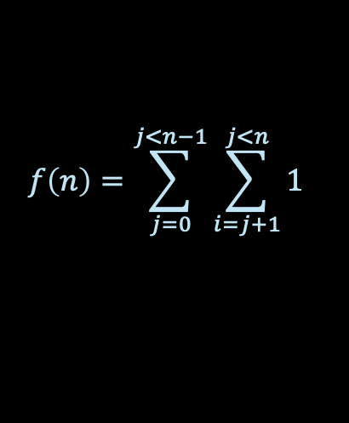

What is
Big-Theta here?
$$f\left(n\right)=\sum_{j=0}^{j<n−1}{\sum_{i=j+1}^{j<n}{1}}$$
$$f\left(n\right) is Θ(n^{2})$$
HOW?

Slide 15
InsertionSort
Unit-03.01.02

Slide 16
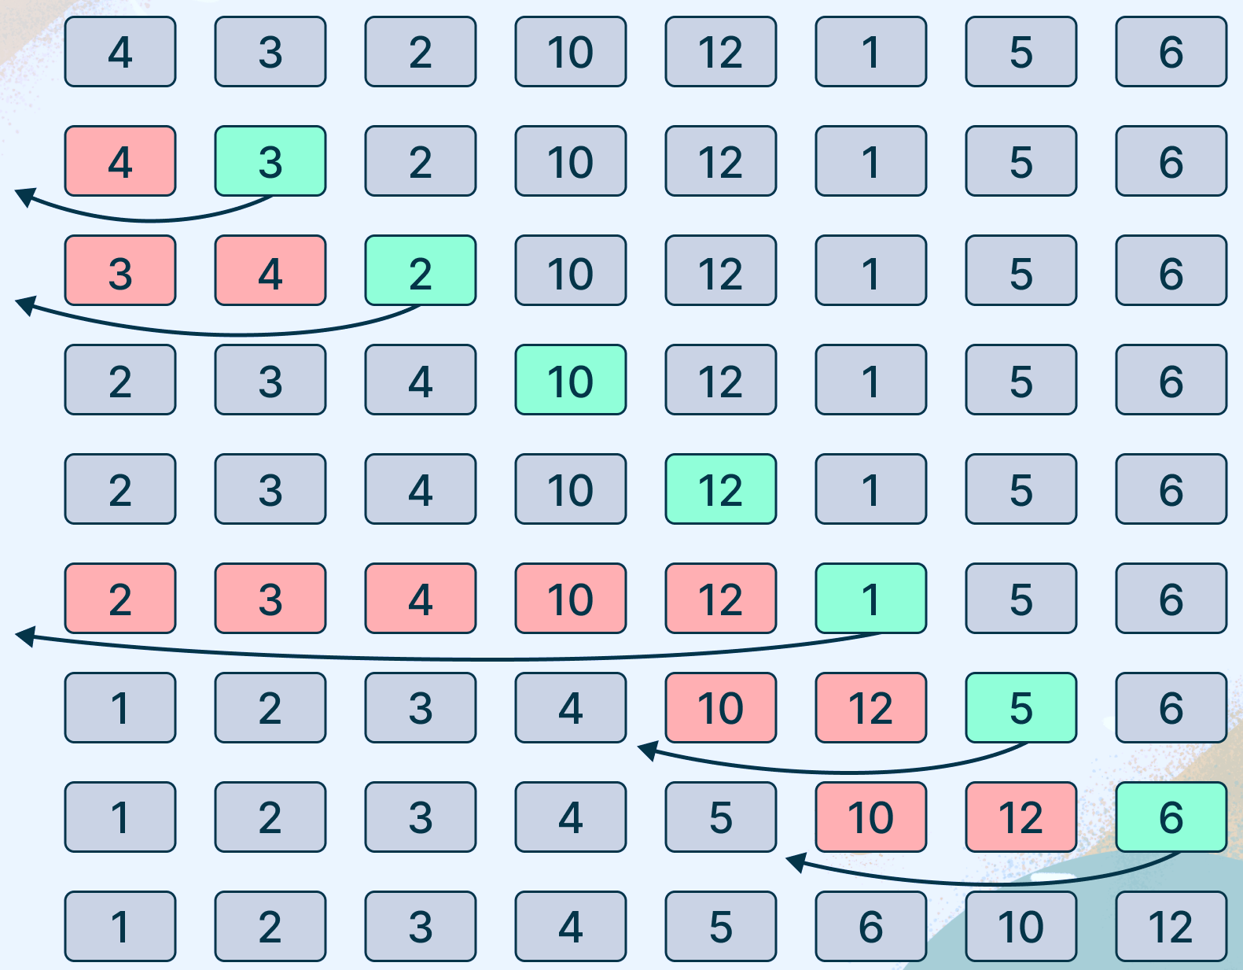
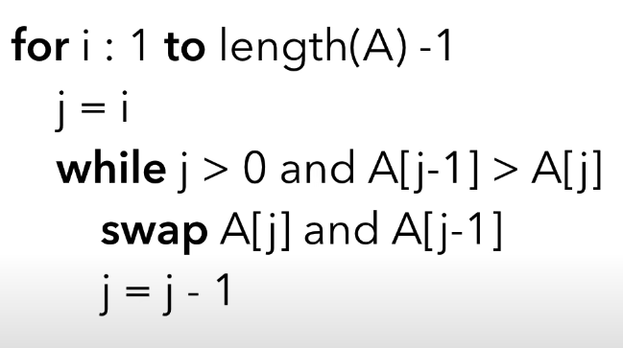

Slide 17

Complexity Analysis.
?? HOW ??
$$f\left(n\right) is O\left(n^{2}\right), best case is n$$
Can you guess best case?

Slide 18
BubbleSort
Unit-03.01.03

Slide 19
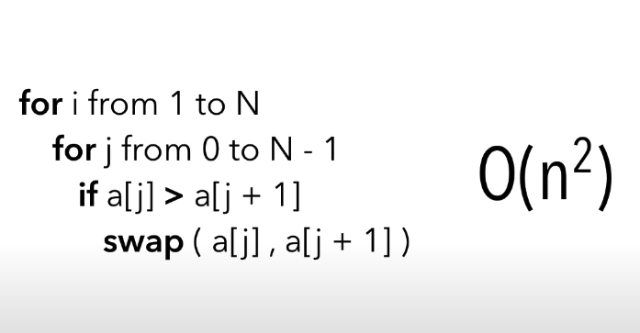
[9, 2, 6, 15, 3,]
[2, 6, 9, 3, 15,]
[2, 9, 6, 15, 3,]
[2, 9, 6, 15, 3,]
[2, 6, 9, 15, 3,]
[2, 6, 9, 15, 3,]
[2, 6, 9, 15, 3,]
[2, 6, 9, 3, 15,]
[2, 6, 3, 9, 15,]
[2, 3, 6, 9, 15,]

Slide 20
[9, 2, 6, 15, 3,]
[2, 6, 9, 3, 15,]
[2, 9, 6, 15, 3,]
[2, 9, 6, 15, 3,]
[2, 6, 9, 15, 3,]
[2, 6, 9, 15, 3,]
[2, 6, 9, 15, 3,]
[2, 6, 9, 3, 15,]
[2, 6, 3, 9, 15,]
[2, 3, 6, 9, 15,]

Slide 21
QuickSort
Unit-03.01.04

Slide 22
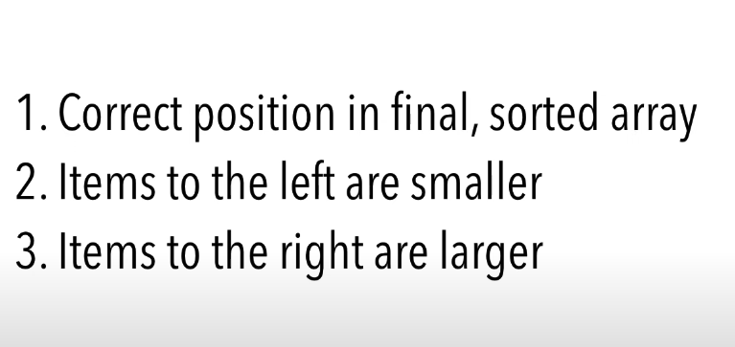
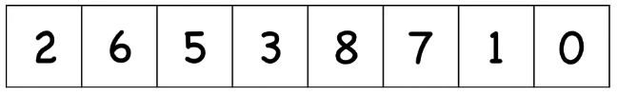

Slide 23
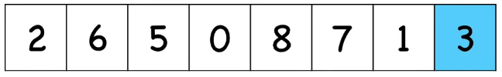
PIVOT

Slide 24
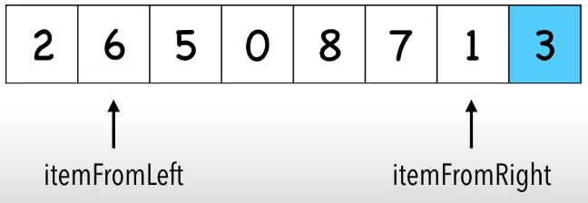
PIVOT

Slide 25
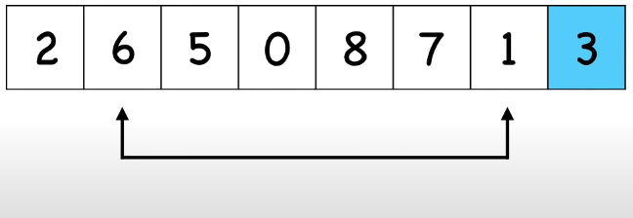
PIVOT

Slide 26
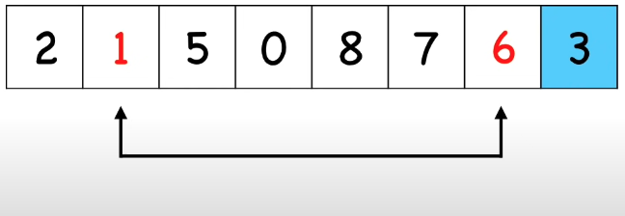
PIVOT

Slide 27
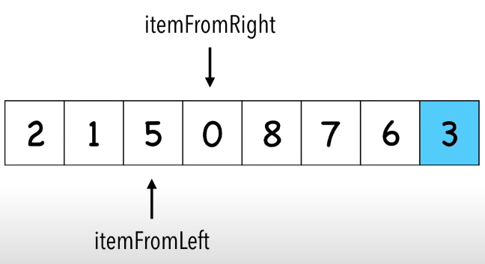
PIVOT

Slide 28
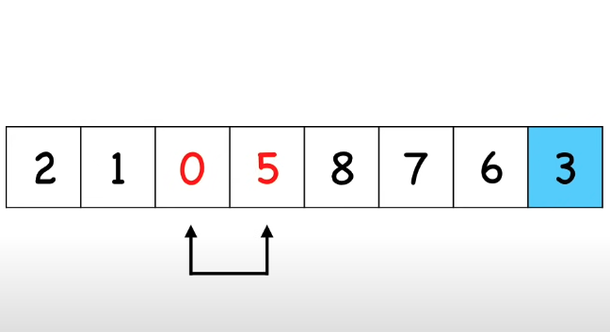
PIVOT

Slide 29
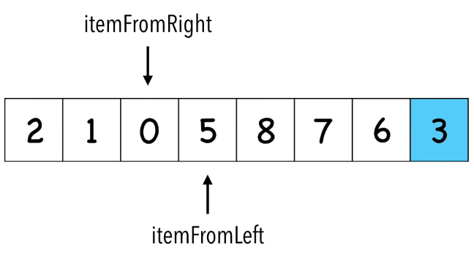
PIVOT

Slide 30
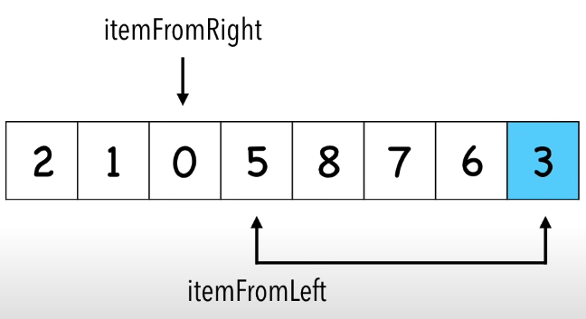
PIVOT

Slide 31
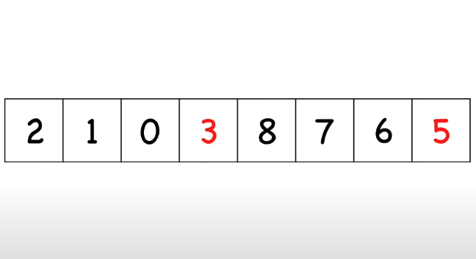
PIVOT

Slide 32
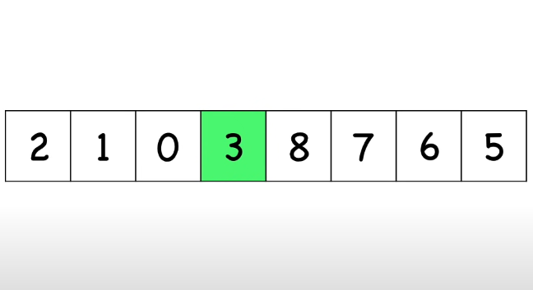
PIVOT

Slide 33
PIVOT
PROBLEM – 1
PROBLEM – 2
REPEAT

Slide 34
PIVOT
PROBLEM – 1
PROBLEM – 2
REPEAT
Resources: https://www.youtube.com/watch?v=Hoixgm4-P4M
Resources: https://www.youtube.com/watch?v=WprjBK0p6rw&t=69s

Slide 35
BUT HOW TO SOLVE?

Slide 36
QuickSort

Slide 37
Algorithms | Divide & Conquer
Unit-03.03

Slide 38
N
N/2
N/2
N/4
N/4
N/4
N/4
N/2^height
How tall this tree will grow?

Slide 39

N
N/2
N/2
N/4
N/4
N/4
N/4
$$\frac{N}{2^{height}}=1, height= ?$$
N/2^height
How tall this tree will grow?
Height is the number of steps we would need…

Slide 40
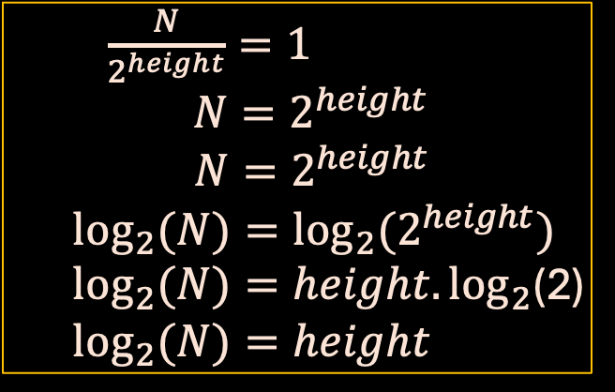
N
N/2
N/2
N/4
N/4
N/4
N/4
$\frac{N}{2^{height}}=1$
$N=2^{height}$
$$N=2^{height}$$
  $$\log_{2}{(N)}={\log_{2}(2}^{height})$$
  $\log_{2}{(N)}=height{.log}_{2}$(2)
  $$\log_{2}{(N)}=height$$
N/2^height
How tall this tree will grow?
N times Height is the number of steps we would need…

Slide 41
N
N/2
N/2
N/4
N/4
N/4
N/4
$\frac{N}{2^{height}}=1$
$N=2^{height}$
$$N=2^{height}$$
  $$\log_{2}{(N)}={\log_{2}(2}^{height})$$
  $\log_{2}{(N)}=height{.log}_{2}$(2)
  $$\log_{2}{(N)}=height$$
N/2^height
How tall this tree will grow?
N times Height is the number of steps we would need…
So total steps required are NlogN

Slide 42
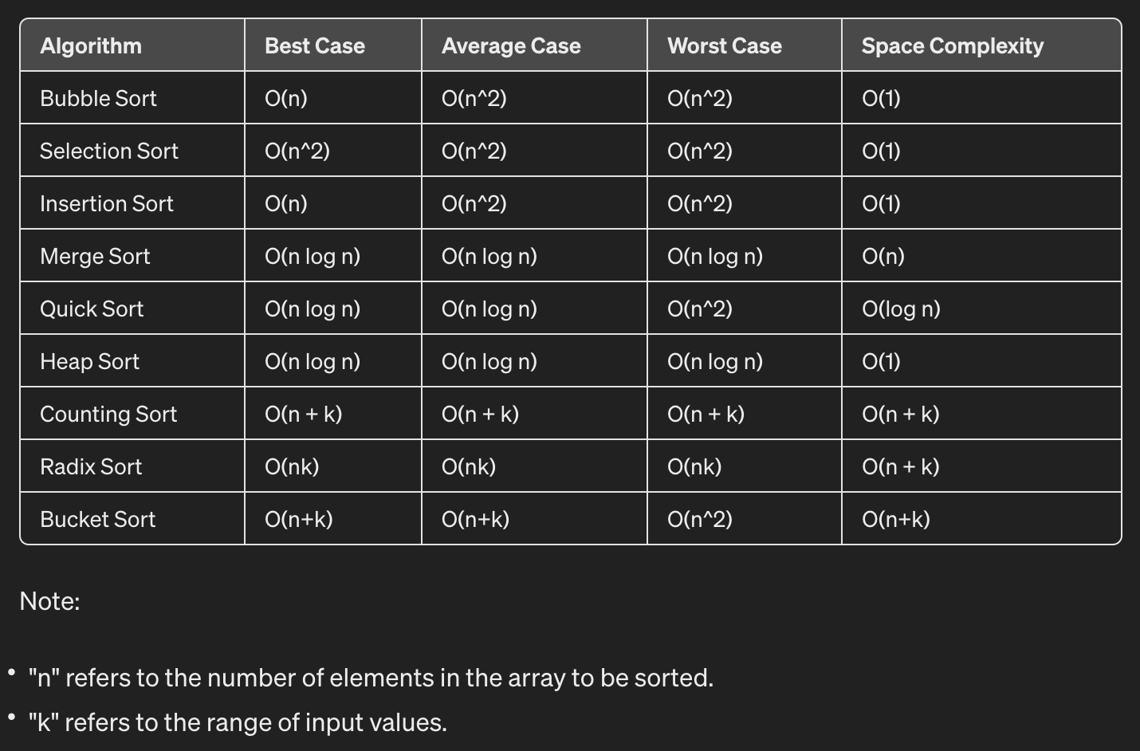
VERIFY FOLLOWING……….bring anything concerning to discussion.

Slide 43
Radix sort, not related with course content
3 5 2 1
011 101 010 001
011 101 010 001
010 011 101 001
101 001 010 011
001 010 011 101
1 2 3 5

Slide 44
Searching
Unit-03.04

Slide 45
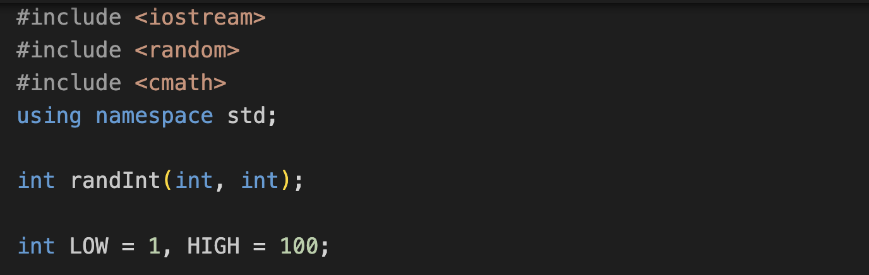
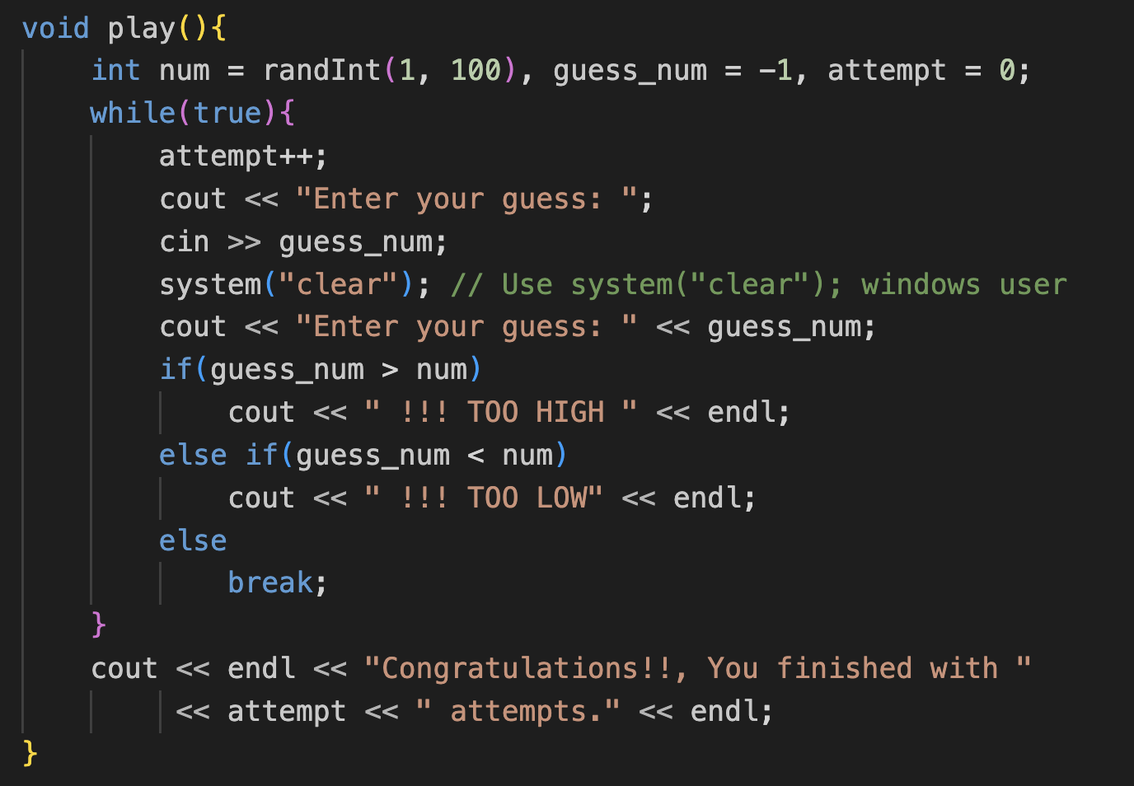
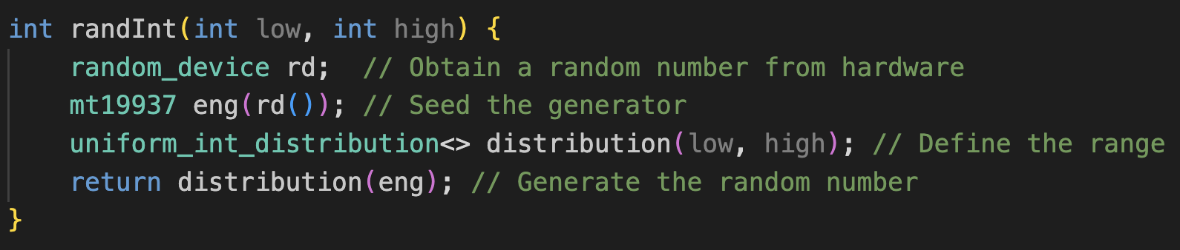
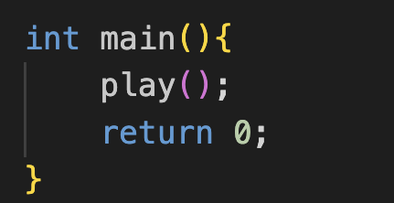
Note, use cls for windows

Slide 46
10M ?

Slide 47
?
?
?
?
?

Slide 48
✔

Slide 49
✔

Slide 50
✔

Slide 51
?
?
?
?
?
1 - step
m - steps
n - step
Worst Case = O(nlogn) + O(n) ~ O(nlogn)
Where is this nlogn coming from?

Slide 52
?
?
?
?
?
1 - step
m - steps
n - step
Worst Case = O(nlogn) + O(n) ~ O(nlogn)
Where is this nlogn coming from?
nlogn time for sorting the array

Slide 53
Can we improve?
(Let’s think linearly one more time)

Slide 54
5
20
7
30
10
9
8
72
51
42
43
55
48
47
55
65
79
61
62
73
55
12
17
19
83
44
55
56
57

Slide 55
4
5
6
7
7
8
8
9
12
12
12
12
13
18
19
19
20
21
21
23
23
23
25
27
32
33
33
33
33
(*Assume different list sorted, compared to before)

Slide 56
4
5
6
7
7
8
8
9
12
12
12
12
13
18
19
19
20
21
21
23
23
25
31
32
32
33
33
41
52

Slide 57
4
5
6
7
7
8
8
9
12
12
12
12
13
18
19
19
20
21
21
23
23
25
31
32
32
33
33
41
52
BUCKETIZATION: Bucket Search
COMPLEXITY?????

Slide 58
Linear Search is not efficient.
You need to visit every elements in worst case.

Slide 59
Can we use our divide and conquer approach?

Slide 60
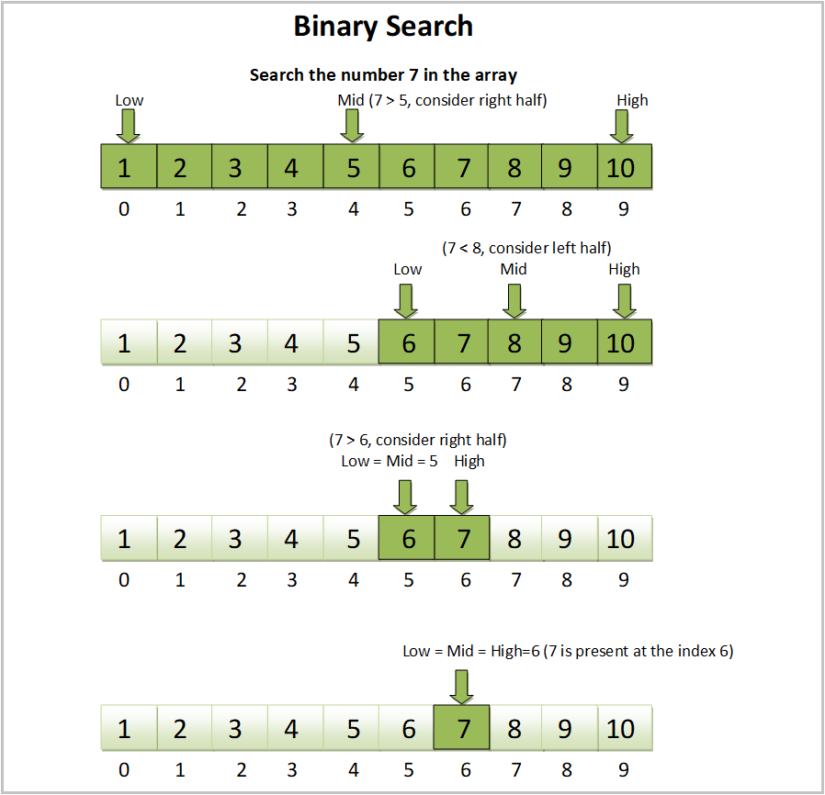
Ref

Slide 61
N
N/2
N/2
N/4
N/4
N/4
N/4
N/2^height
How tall this tree will grow? What is our BigO
Ref

Slide 62
N
N/2
N/2
N/4
N/4
N/4
N/4
N/2^height
How tall this tree will grow? What is our BigO? O(logn)
Ref

Slide 63
Lets start coding….

Slide 64
One last challenge……..ready for your first internship coding interview?

Slide 65
One last challenge……..ready for your first internship coding interview?

Slide 66

meet our Bobcat…..

Slide 67
We plan to invite 5 of them….. but there is a problem…..

Slide 68
they fight if we put them too close……

Slide 69

0
2
7
10
18
22

Slide 70



0
2
7
10
18
22
Can we
place them
by… distance?
1 Unit
2 Unit
3 Unit
4 Unit

Slide 71


0
2
7
10
18
22
Can we
place them
by… distance?
1 Unit
2 Unit
3 Unit

Slide 72
arr [] = [ 0, 3, 4, 7,9, 10], bobcats = 4
What is the maximum minimum distance you can place 4 bobcats together given above placements?

Slide 73
arr [] = [ 0, 3, 4, 7,9, …..99….845……1M……100M…2B]
4 bobcats, what is that minimum?
What is the maximum minimum distance you can place 4 bobcats together given above placements?

